Slide 1
Multilingual Hope Speech Detection
Low-Resource and Code-Mixed Settings
Detecting supportive and encouraging content in Tamil, Malayalam, and English
Anjana Kopparthi Data Science, Rochester Institute of Technology Advisor: Aashique Khudabuksh

Slide 2
What is Hope Speech? 🤔
Hope speech = Messages that comfort, encourage, and promote optimism
✓ Hope Speech Examples
"I know this is hard, but you are not alone“
"Things will get better“
"I'm here if you need someone“
"Stay strong, you can do this"
✗ Non-Hope Examples
"There is no hope left“
"Just smile and stop complaining" (toxic positivity)
"Nobody cares about your problems“
“Others have it worse; cheer up!"
Key Insight: Hope speech is NOT just the opposite of hate speech!

Slide 3
Why is Hope Speech Detection Challenging? 😰
Subtle expressions: "I'm here if you need someone" has no explicit "hope" word
Negation patterns: "I have hope" vs "I have no hope left"
Code-mixing: "entha feel ayya but still I know things will improve"
Script variation: Tamil/Malayalam in native script vs romanized
Low-resource languages: Limited labeled datasets for Tamil & Malayalam
Toxic positivity: Sounds positive but invalidates feelings

Slide 4
Project Goals
Detect hope speech in English, Tamil, and Malayalam
Handle code-mixing and script variation (native/romanized)
Address low-resource language challenges
Distinguish hope from toxic positivity
Build interpretable baseline → scale to transformers

Slide 5
Datasets Used 📊
1. HopeEDI Dataset
English samples
Tamil samples
Malayalam samples
Labels: hope, non-hope, not-in-language
Issue: Highly imbalanced (more hope than non-hope)
2. Jigsaw Toxic Positivity
English only
Emotionally supportive comments
Discouraging comments
Toxic positivity examples
3. YouTube Comments (Exploratory)
Manually collected from Telugu, Tamil, Malayalam videos: motivational talks, devotional content, mental health awareness channels
Next Semester: Large-scale automated scraping planned
Challenge: Class imbalance - HopeEDI heavily skewed toward hope speech

Slide 6
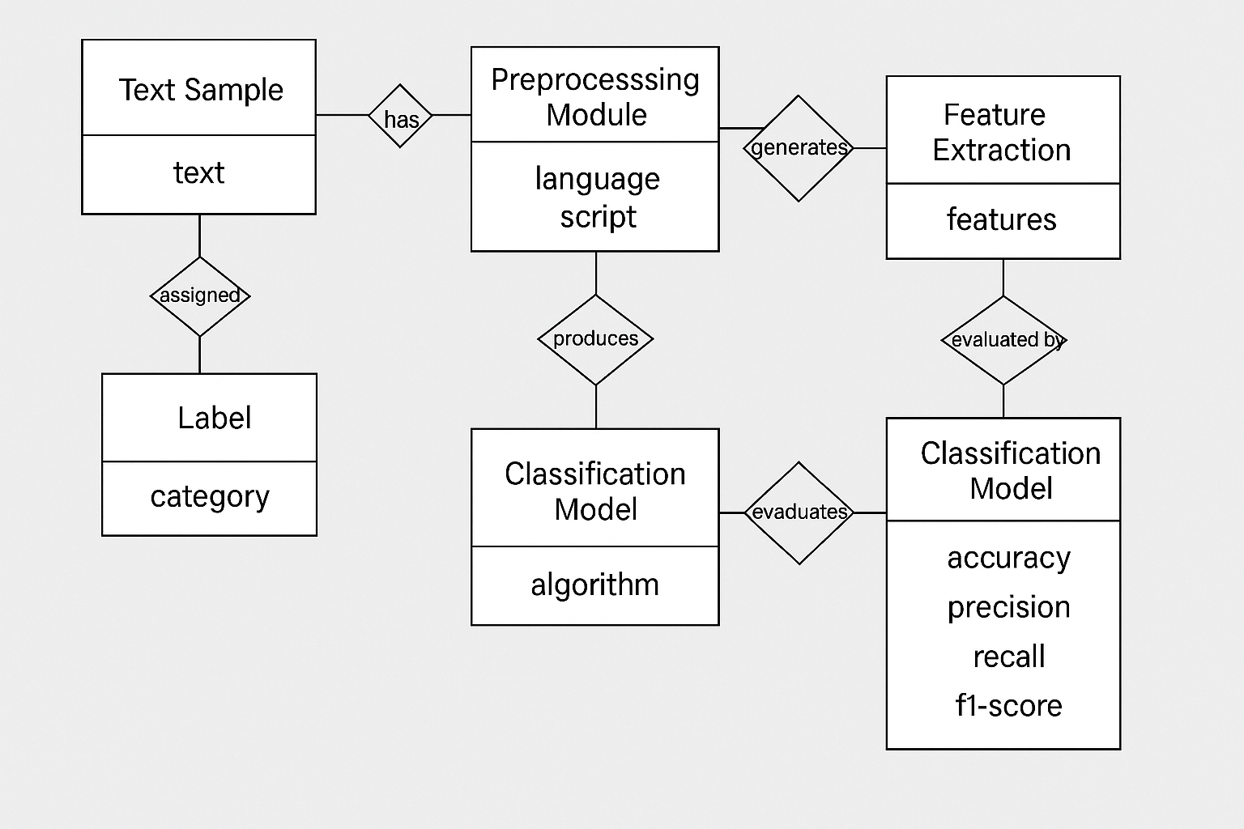
Domain model Overview 🏗️
evaluates
The domain model defines how Text Samples flow through Preprocessing and Feature Extraction into the Classification Model, which produces Labels evaluated using standard Performance Metrics.

Slide 7
System Architecture Overview 🏗️
Data Layer: HopeEDI + Jigsaw + YouTube
Preprocessing: Normalization, Negation Detection
TF-IDF Features
Transformer Tokens
Logistic Regression
XLM-Roberta (planned)
Evaluation & Error Analysis
Progressive Complexity Design: Start with interpretable baselines → Scale to advanced transformers

Slide 8
Code Presentation

Slide 9
Preprocessing Pipeline 🔧
Critical Steps
Unicode Normalization (NFC): Handle visually identical characters in Tamil/Malayalam
Noise Removal: Remove URLs, HTML, repeated punctuation
Emoji Preservation: Keep emojis (they encode emotional intensity!)
Script Variant Tagging: Classify as native/romanized/code-mixed
Negation Detection: Flag sentences with negation + hope words
Label Normalization: Map to integers (hope=1, non-hope=0, not-in-lang=2)
Special Handling: If text contains "hope" word + negation → Override to NON-HOPE

Slide 10
Baseline Model: TF-IDF + Logistic Regression 📈
Implementation Details
COMPLETED
Features: TF-IDF with unigrams, bigrams, trigrams
Max vocabulary: 5000 features
Classifier: Logistic Regression with class-weight balancing
Library: scikit-learn
Sparse matrix output
Transformer Tokenization
PLANNED
XLM-R tokenizer
Subword tokenization
Max length: 128
Multilingual embeddings
Purpose
✓ Establish interpretable reference model
✓ Create performance lower bound for transformer comparison

Slide 11
Baseline Results 📊
Language | Accuracy | Precision | Recall | F1-Score | Assessment
English | 80.4% | 91.8% | 80.4% | 84.2% | ✅ Good baseline
Tamil | 63.4% | 63.3% | 63.4% | 63.3% | ⚠️ Moderate
Malayalam | 30.3% | 82.3% | 30.3% | 38.0% | ❌ Poor - needs transformers
Observation: English performs well, but Tamil and Malayalam struggle significantly with TF-IDF baseline

Slide 12
Error Analysis & Key Findings 🔍
Common Failure Patterns
Toxic positivity misclassification: "Just smile and stop being weak" → predicted as HOPE
Code-mixing challenges: TF-IDF treats English + Tamil as separate bags of words
Sarcasm: "Oh great, another failure, what a surprise" → misclassified
Cultural expressions: Tamil/Malayalam idioms not captured by lexical features
Why Malayalam Failed: Complex morphology + script diversity + class imbalance + sparse data = poor generalization

Slide 13
Next Phase: Multilingual Transformers 🚀
XLM-Roberta Fine-tuning (Planned for Next Semester)
Why XLM-R?
Pre-trained on 100 languages
Shares subword representations across scripts
Handles code-mixing naturally
Captures long-range dependencies
Understands context & semantics
Implementation Plan
Model: xlm-roberta-base
Learning rate: 2e-5
Batch size: 16
Epochs: 3
Library: HuggingFace Transformers
Expected: Significant improvement over baseline

Slide 14
Future Work (Next Semester) 🔮
1. Large-Scale YouTube Scraping
Automated extraction of 10k+ comments in Telugu, Tamil, Malayalam from motivational videos, mental health channels, devotional content
2. Multilingual Annotation Guidelines
Consistent labeling framework for hope, non-hope, toxic positivity across languages
3. Transformer Fine-tuning
XLM-Roberta / mBERT training on combined datasets
4. Toxic Positivity Dataset Expansion
Especially for Tamil and Malayalam (currently underrepresented)

Slide 15
Conclusion & Impact 🎯
Key Accomplishments
✓ Built complete preprocessing pipeline for multilingual hope speech
✓ Established baseline performance metrics (English: 80.4%, Tamil: 63.4%, Malayalam: 30.3%)
✓ Identified critical challenges: negation, code-mixing, toxic positivity
✓ Validated need for transformer-based approaches
Broader Impact
Enables positive content moderation, mental health support systems, and community resilience monitoring for non-English speaking populations

Slide 16
References
[1] T. Davidson, D. Warmsley, M. Macy, and I. Weber, "Automated hate speech detection and the problem of offensive language," in Proc. ICWSM, 2017, pp. 512-515.
[2] B. R. Chakravarthi et al., "Overview of the shared task on hope speech detection for equality, diversity, and inclusion," in Proc. EACL Workshop, 2021, pp. 61-72.
[3] J. Devlin, M.-W. Chang, K. Lee, and K. Toutanova, "BERT: Pre-training of deep bidirectional transformers for language understanding," in Proc. NAACL-HLT, 2019, pp. 4171-4186.
[4] A. Conneau et al., "Unsupervised cross-lingual representation learning at scale," in Proc. ACL, 2020, pp. 8440-8451.
[5] S. Quintero and J. Long, "Toxic positivity: The dark side of positive vibes," The Psychology Group, vol. 12, no. 3, pp. 1-8, 2020.
[6] Jigsaw and Google, "Toxic Comment Classification Challenge," Kaggle, 2017. [Online]. Available: https://www.kaggle.com/c/jigsaw-toxic-comment-classification-challenge

Slide 17
Code Run

